Slide 1
ENTREPRENEURSHIP & INNOVATION
STARTING-UP & GROWTH
Antti Paasio
Professor of Entrepreneurship and Business
BID/UTU
25.8.2011

Slide 2
W.Baumol et.al (2009) Growth Miracle Maker, Growth Saboteur
”It is necessary, I believe, to give more weight to economic culture...the Continent (and to some extent, the United Kingdom, too) is in the grip of a culture hostile to enterprise and innovation”

Slide 3
Kenneth Arrow:
”Innovations, almost by definition, are one of the least analyzed parts of economics, in spite of the veritable fact that they have contributed more to per capita economic growth than any other factor”

Slide 4
J.M.Keynes (1920)
”Entrepreneurship is the active and constructive element in the whole capitalist society”

Slide 5
Roy Thurik (2004)
”entrepreneurship has emerged as the engine of economic and social development throughout the world”

Slide 6
ENTREPRENEURSHIP Phenomenon BY Peter Drucker, Innovation and Entrepreneurship (1984)
Entrepreneurs are much more sophisticated and versatile innovators than what statistics tell us (Schumpeter brought back to honour and glory!)
Entrepreneurial management is one of the key innovations (see later HAMEL)
Entrepreneurship is about NOT FOLLOWING the Kondratjeff cycle (bust-to-boom-to-bust...)
Entrepreneurship is about innovation (= Opportunity recognition)
Basic functions of the entrepreneur:
  A.Smith 1776: the humble servant of the invisible hand
    Pareto optimality excludes real entrepreneurship and innovation
  J.Say (1800): ...shifts economic resources from lower productivity into higher productivity areas
  Knight (1921) Risk vs. uncertainty
  Robert Solow Economic Papers 1956&1957: growth = physical capital + labour (unexplained = technological advance)
  Samuelson: Economics: no mention of entrepreneurship or SMEs!!!
  Hayek & Keynes (1920s) >>> Herbert Simon et.al (1963) Bounded rationality
  Starts-up, owns, and manages a company (but not all SMEs are entrepreneurial), like McDonalds, UPS...
Drucker requires an element of Schumpeterian disruption of an entrepreneur
  ...is not a personality trait!!!

Slide 7
Reality Check?
“It must be considered that there is nothing more difficult to carry out, no more doubtful of success, no more dangerous to handle than to initiate a new order of things.” (Machiavelli: Prince, p.51)
“When an inventor in Silicon Valley opens his garage door to show off his latest idea, he has 50% of the world market in front of him. When an in inventor in Finland opens his garage door, he faces three feet of snow.” J.O. Nieminen, CEO of Nokia Mobira, 1984

Slide 8
Innovation and Growth are
HOT policy issues
Innovations drive economies more than ever before (?)
  Life cycles of business models get shorter, hence renewal
(Fast) Growth creates
  Wealth
  Jobs

Slide 9
In Biz Schools...
MANAGEMENT
mgt technologies
formal management
organizational doctrine
strategic planning
LEADERSHIP
leader person traits
charisma
Strategic management
ENTREPRENEURSHIP
change engine, healer
innovator, networker, developer
disruptor
life-style vs professional entrepreneur
knowledge-intensive creator of future
way to learn/act
mindset
INNOVATION
Closed>>Open

Slide 10
Entrepreneurship is multidisciplinary
TECHNOLOGY
LAW
PSYCHOLOGY
ECONOMICS
ENTREPRE-
NEURSHIP
SOCIOLOGY
SOCIAL PSYCHOLOGY
BUSINESS ECONOMICS
PEDAGOGY
PHILOSOPHY

Slide 11
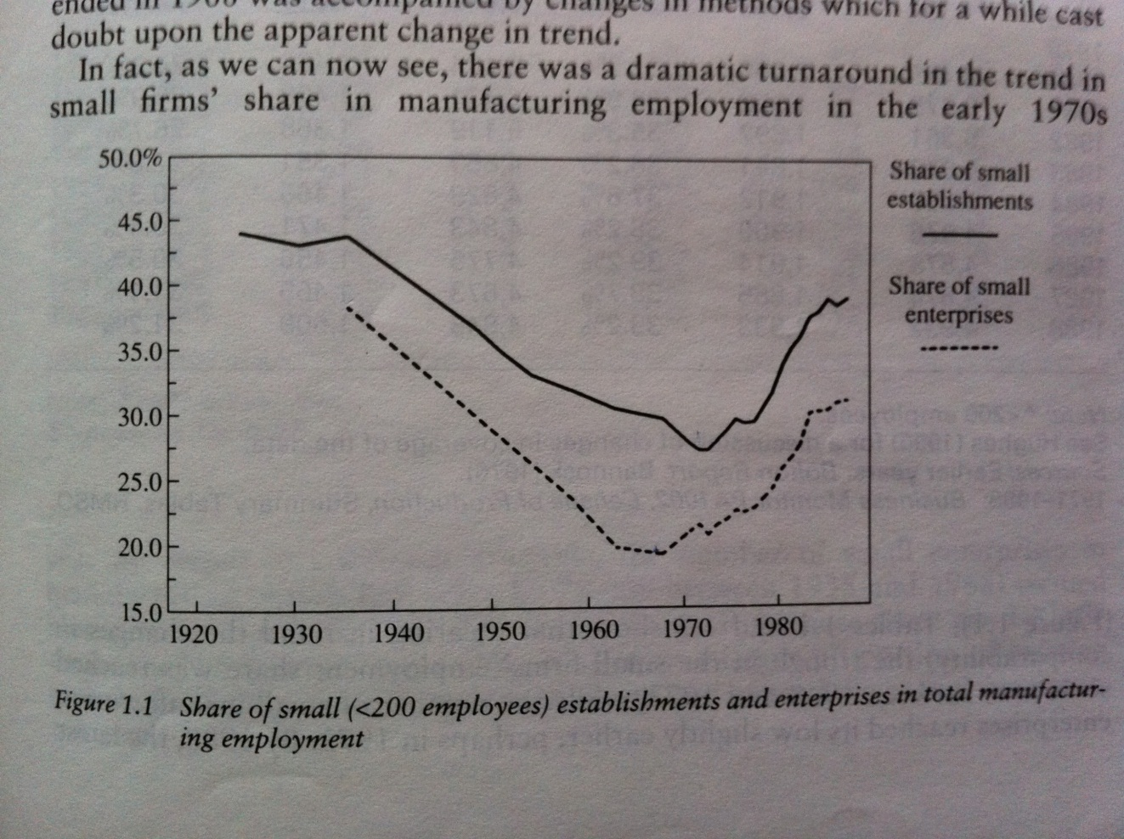
ENTREPRENEURSHIP came back in the 70s
WHY???
From:
Bolton 20 Years On:
The Small Firm in the 90’s (Starworth&Gray 1991)

Slide 12
ENTREPRENEURSHIP MAKES A DIFFERENCE
New firms are more numerous than new marriages or new babies
New firms account for one quarter (more?) of new jobs
Knowledge-Intensive firms are the engines of the national economy ➔ universities are brought at the forefront

Slide 13
Entrepreneurship Creates Wealth
IMPORTANCE
OF
ENTREPRENEURSHIP
LARGE FIRMS DOMINATE
PUBLIC SECTOR GROWTH
WEALTH OF
NATION
FIN
(Thurik/GEM)

Slide 14
EU defines companies as…
0-9 micro
10-49 small
50 – 249 medium-sized
250 - large
SME
99 %

Slide 15
And we NEED these new businesses!
Start-ups and
high-growth SMEs
Create “all” jobs
Knowledge-intensive
Innovative/Entrepreneurial firms
Create wealth and welfare
ICT LABS
SMEs are a must for regional welfare
SMEs can do
anything!

Slide 16
HBR September 2010
”We need out-of-the-box thinking, audacious goals, and lots of experiments. Today’s entrepreneurs bring all that and more to the table.”

Slide 17
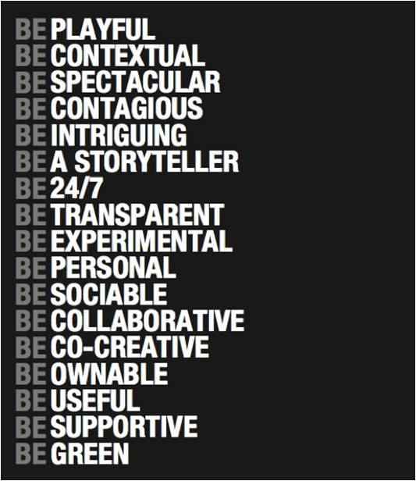
THINK!
Are YOU like this?
DEMAND FOR THESE COMPETENCIES IS INCREASING !
HOW CAN ONE MAINTAIN THESE QUALITIES IN LARGER OPERATIONS?

Slide 18
It does not always have to be biiiig…
The real magic of discovery
lies not
in seeking new landscapes
but
in having new eyes
Marcel Proust

Slide 19

Does HE look like an Entrepreneur?
”Aim to be THE BEST or stop aiming”
Could/should HE be a model for us YOU?
He is Peter Vesterbacka drom ROVIO

Slide 20
Case ROVIO
Turnover 2006-2009: 748=>1472=>1604=>1449=>?
Angry Birds was the 52nd game Rovio developed (after 6 years of death valley)
  A team of 4 developed the game as it was a low priority to the company
  Development costs around 100.000 euros
  Patience, persistence, customer focus, LUCK!!!
  Earlier games made some profit
  Marketing essential, additional merchandise
PV has an HP background 1992-2005, is a serial entrepreneur
A VC of 43M$ afterwards
Estimated market value 700 - 1000 million € (Forbes July 2011), why?

Slide 21
Case ROVIO

Slide 22
Case ROVIO

Slide 23
Case ROVIO

Slide 24
Case ROVIO

Slide 25
Why 1 000 000 000 € ???
Entrepreneurial value is EXPECTATIONS-DRIVEN
  Can ROVIO become the next Disney?
Entrepreneurial value is PERSONALITY-DRIVEN
Product, team, process, network, ....

Slide 26
Just to have a perspective....
http://blogs.wsj.com/digits/2011/08/24/steve-jobss-best-quotes/
Interesting stuff, but the conclusion is that every entrepreneur must build his/her development on his/her own personality and capacity
The other observation is that entrepreneurship can be learned and there is no specific exclusive definition of the entrepreneurial type. We can all improve!!!

Slide 27
The Masteries of Entrepreneurship
Mastery of Opportunity recognition
Ability to recognise opportunities and “co-create future”
Mastery of Approach
Ability to select a proper approach to meet key Entrepreneurship Outcomes
Mastery of Philosophy
Ability to pitch the relevance of new venture to whom it might concern
Mastery of Strategy
Ability to assess the organisation change requirement and and pursue appropriate strategies
Mastery of Operations
Ability to apply strategy
Mastery of Networks
Ability to harness the potential of all related stakeholder networks (including customers!)
Mastery of Failure
Ability to withstand failure and build on it
SEE: www.3ep.eu

Slide 28
The Masteries (adopted)...
Mastery of Process
Ability to organise knowledge appropriately around development problems and opportunities
Mastery of Disruption
Ability to change the rules of the game
Mastery of Resource Acquisition
Ability to identify and engage sources of support for business development including funding and support in kind.
Mastery of Personal Entrepreneurship
Ability to demonstrate personal entrepreneurial behaviour – take risks – grasp opportunities - take initiatives etc. and be a role model.
ENTREPRENEURSHIP IS A MINDSET!

Slide 29
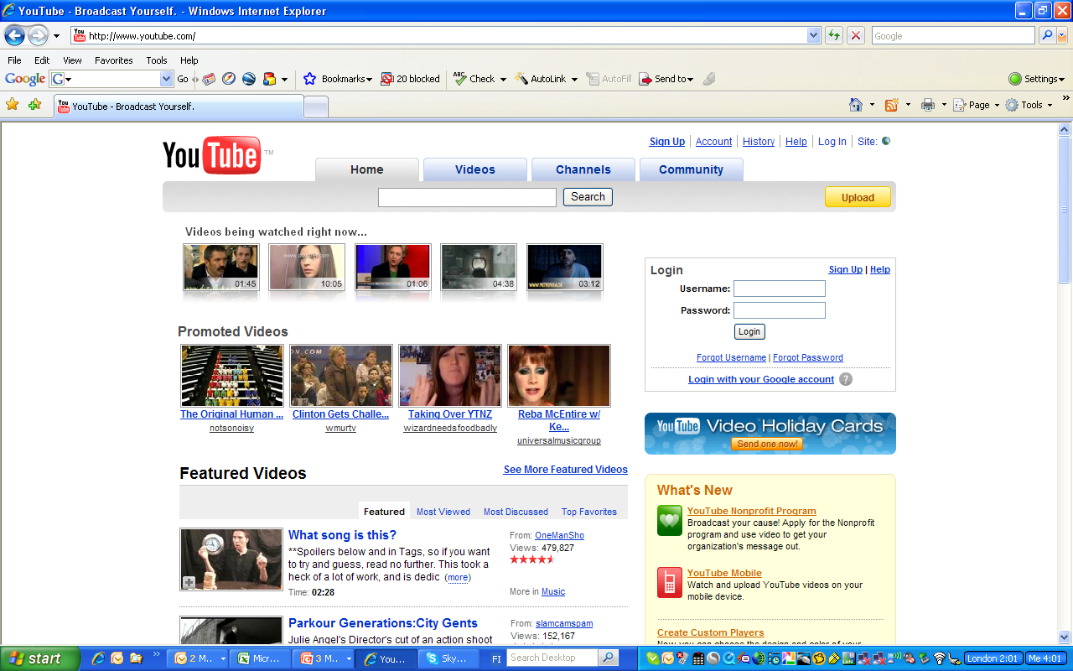
Every firm must be Medician (well, almost…)
A solid business model
+
HYBRID BUSINESS
Lawrence Lessig: Remix

Slide 30
A VERY SHORT HISTORY OF INNOVATION (See Swann (2009) The Economics of Innovation
Adam Smith (1723-1790):
  Division of labour (Rae 1796-1872 argued for invention)
John Stuart Mill (1806 – 1873)
  There is a black side to invention
Karl Marx (1818 – 1883)
  The bourgeoisie must constantly revolutionise the means of production
Alfred Marshall (1842 – 1924)
  Consumer as an innovator
Thorstein Veblen (1857 – 1929)
  Invention is the mother of necessity
Joseph Schumpeter (1883 – 1950
  Creative destruction
Lewis Mumford (1895 – 1990)
  It’s the clock, not the steam engine

Slide 31
Innovation (Schumpeter 1934; Baumol 1990)
A new good or a new quality of a good
A new method of production not previously tested, that does not need to be founded upon scientific discovery
Opening a new market, ie. a market that a firm has not previously entered, whether or not this market has existed before (Ansoff’s product/market matrix)
A new source of supply of raw materials, irrespective of whether this source already exists or has first to be created
The carrying out of new organisation

Slide 32
Kenneth Arrow (1921 - )
  Underinnovation tendency >> public intervention needed
Robert Solow (1924 - )
  Labour+capital is not enough, tech change is essential => innovation again in the centre
Nathan Rosenberg (1927 - )
  Tech-push and demand-pull are BOTH needed
Richard Nelson (1935 - )
  Biological metaphor of evolution to explain innovation
Eric von Hippel (1941 - )
  Importance of user, customer, or consumer
Clayton M. Christensen
  Problems of maintaining innovativity in large and growing organizations, and solutions also
  DNA of the Innovator
Henry M. Chesbrough (200x -)
  Open innovation, open business models

Slide 33
INNOVATING INNOVATION 2000
Schumpeter started with (entrepreneurial) disruption as the key element
Drucker linked E&I very strongly
The R&D and Tech-Push era (whose idea was that originally?)
The Christensen and von Hippel school
The Chesbrough School
Jan-Marie Dru: Disruption
The Lessig Hybrid school
HARD
VS.
SOFT
R&D
??

Slide 34
Driving Forces behind Innovations
Customer needs
”New needs”
Technology development
R&D
Growth oriented entrepreneurship
Internationalisation/globalisation
Research & teaching
Access to data (customer, local, national,…)
New add-ons
Combining existing product/services
Digitalisation
Other?

Slide 35
Current Trends in Technology/innovation
From technology development to innovation
Customer/end-user focus
Digitalisation of products and services
Blue ocean strategies, long tail
Communities
Co-operative R&D
Complementary skills involved in R&D
International focus from the beginning
Flexibility

Slide 36
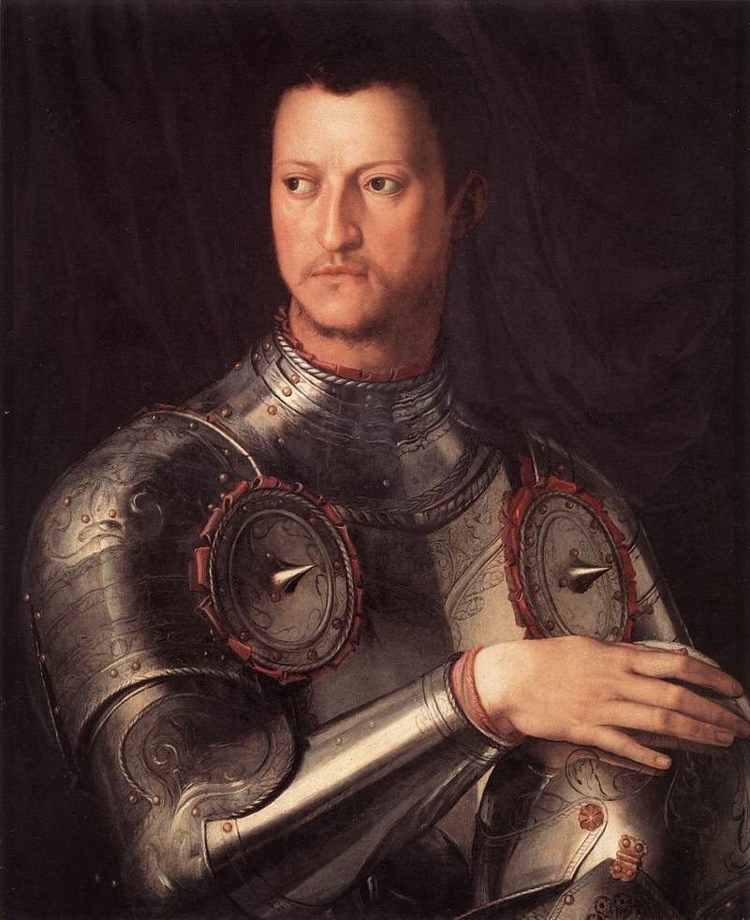
Remember the MEDICIs!
Bring different
talents together
=
Renaissance
=
Innovation
The Medici Principle
EIT, too??

Slide 37

RESOURCES, PROSUMERS, ...
INNOVATIONS ARE NOW WIDELY REGARDED AS STORIES
INNOVATIONS ARE INCREASINGLY CARRIED OUT IN NETWORKS = OPEN INNOVATION
CUSTOMERS ARE NO LONGER JUST TARGETS, THEY ARE PART OF THE PRODUCT
BUSINESS MODEL INNOVATIONS ARE PROBABLY THE STRONGEST MOVERS
  FREE OFFERS: SKYPE, GOOGLE, FACEBOOK, SOME AIRLINES
  BUSINESS MODELS ARE POORLY HANDLED IN LITERATURE
THOUSANDS OF ENTREPRENEURS
IMMEDIATELY SELLING GLOBALLY
ANGRY BIRDS (ROVIO, FIN!!)

Slide 38
Henry Chesbrough
“As I studied the Xerox spin-off companies, I came to understand that their success or failure depended far less on the quality of the technology they developed, and far more on their ability to identify a real customer problem that this technology could solve, and then build a value chain to deliver that solution. No start-up got the business model right initially. All of them had to iterate and adapt as they went, unless they died first. This agility is hard to replicate in larger companies, which is why I advise larger companies to pay close attention to the start-ups in and around their industry.”
http://www.emeraldinsight.com/Insight/ViewContentServlet?Filename=Published/EmeraldFullTextArticle/Articles/2610330103.html

Slide 39
HC continued…
“A lot of research shows that there are roles for the “lone wolf” in the breakthrough categories of innovation, but that innovation overall is a team sport. In truth, this is not an “either or” situation; it is an “and” situation, in that organizations that promote innovation will attract innovative people, and innovative people will help stimulate a company to remain innovative. Finding these people requires both formal and informal networks, and searching for people whose experience is not simply from the “best” companies, but perhaps from start-up companies or universities as well.”

Slide 40
Innovation Evolution
OPEN INNOVATION
ENVIRONMENT
TECH PUSH
PUSH+PULL
Invention
R&D
Invention
R&D
TECHNOLOGY AS
CHANGE DRIVER
LARGE
INNOVATION
NETWORK
Commercialisation
Commercialisation
INNOVATION
AS
CONTINOUS
CHANGE
PROCESS
Innovation =
BUSINESS
OPPORTUNITY
DYNAMIC
BUSINESS
MODELS
Innovation=
Scarce resource
(patent)
Market-driven
Opportunity signals
MARKETS AS
CHANGE DRIVER
ECONOMIES OF SCALE : PROGRAMS,
PRIORITIES, FOCUSED VALUE-ADDED
INTERFACE OF THE DIFFERENT
INTERACTION, DYNAMICS

Slide 41
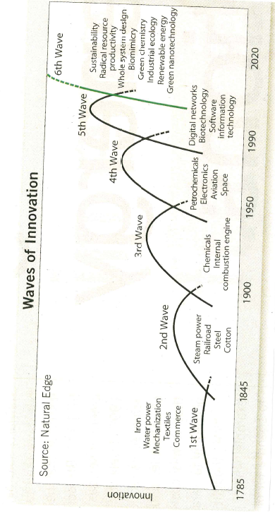
What Next?

Slide 42
Next Big Ones?
Smart Phones
Data, data, data…
Smart Electronics
GreenTech
Personally, I believe that Service and Design (broadly defined) are important drivers in the future

Slide 43
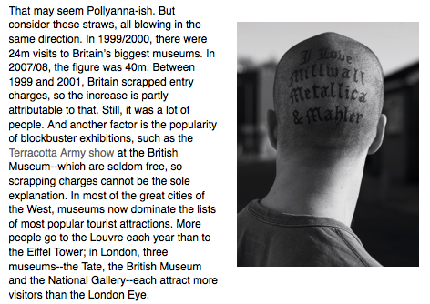

Bonniers today: “2009 the best year in book publishing during the last 200 years”

Slide 44
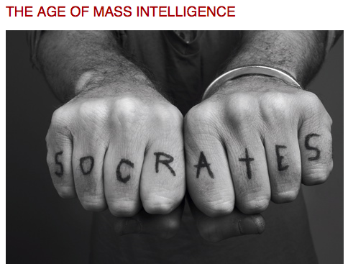
INTELLIGENT LIFE, March 2009
OR...MASS STUPIDITY?
http://www.moreintelligentlife.com/story/age-mass-intelligence

Slide 45
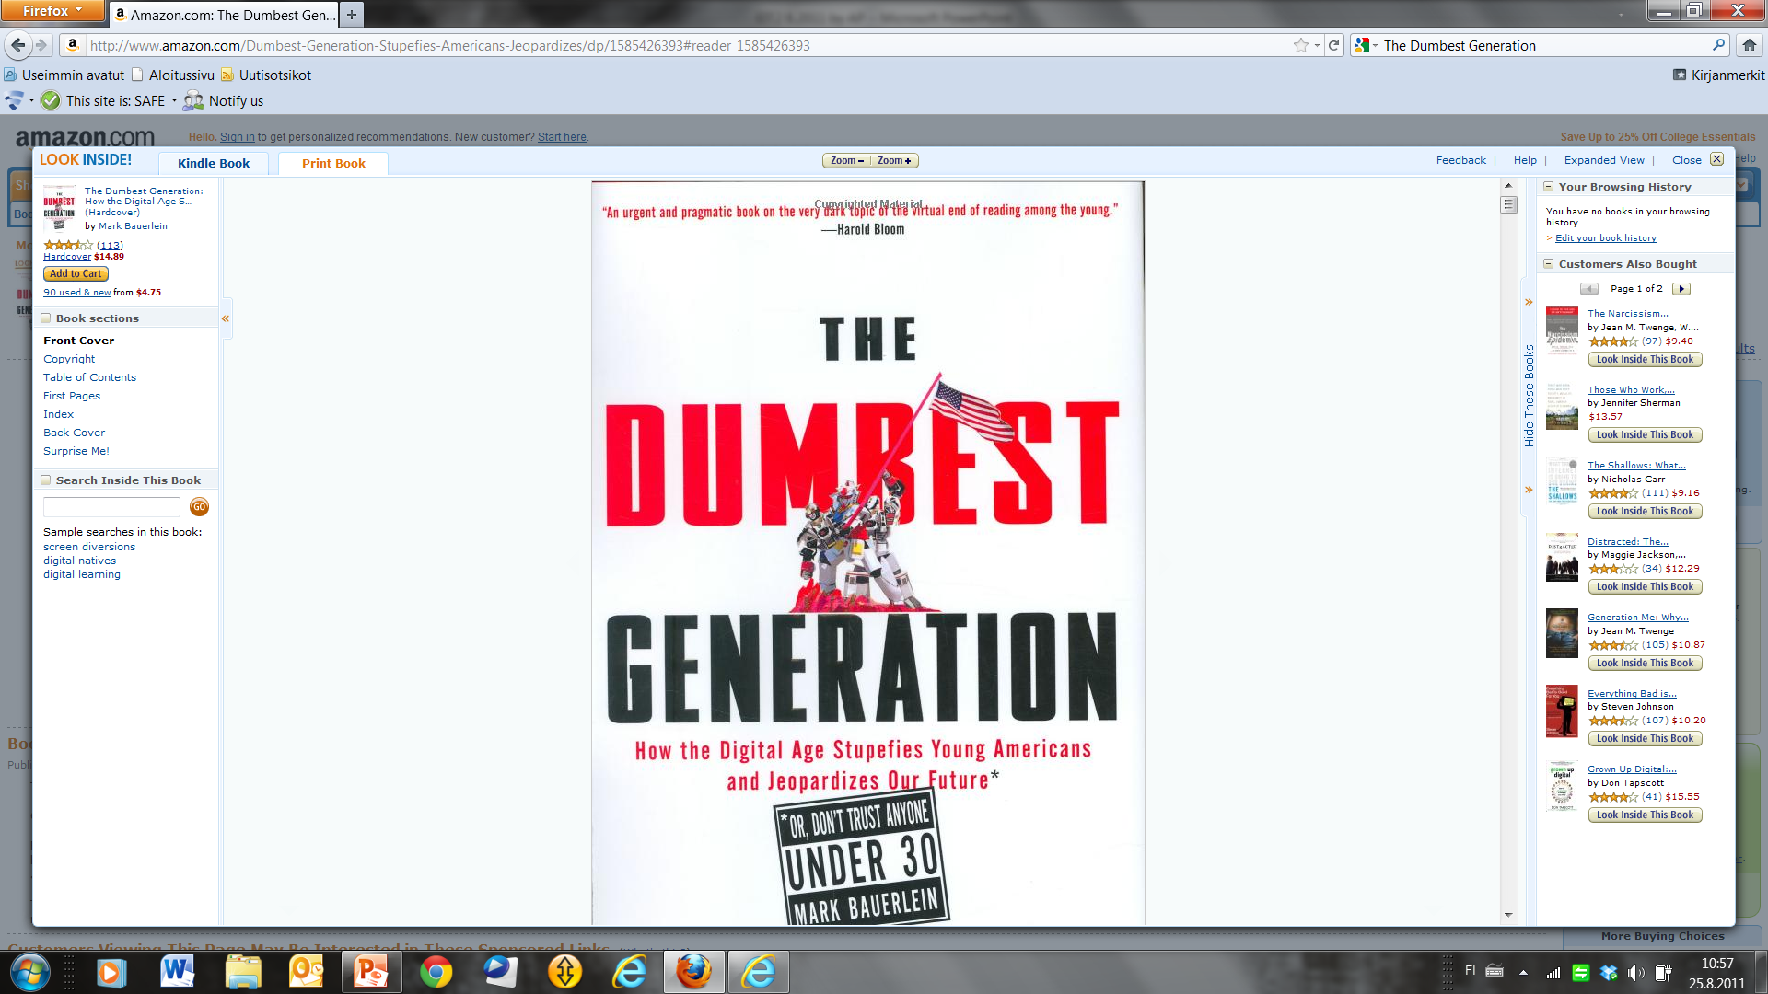
Or: The Dumbest Generation?

Slide 46
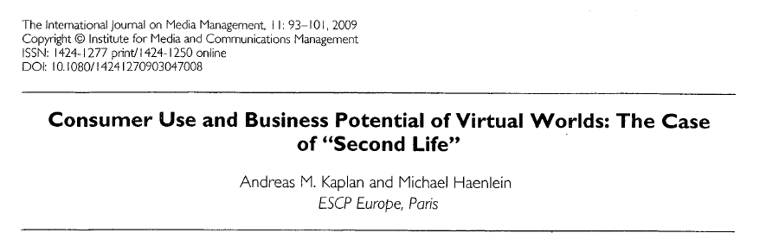
Read and think…

Slide 47
But, the worst flops are….
10. Virtual reality
9. Alternative search engines
8. Speech recognition
7. LISA (Local Intergrated Software Architecture) by Apple
6. 10 Gigabit Ethernet
5. Firewire
4. Bluetooth
3. ITANIUM by INTEL
2. ZUNE by Microsoft
1. WINDOWS VISTA by MICROSOFT
Do you agree?
(by PC Authority, Australia)

Slide 48
Disruption
UNIVERSITY AS CREATOR OF
BEST KNOWLEDGE
ON ITS OWN
”SCIENTIFIC QUALITY CONTROL ONLY” IS BEST
UNIVERSITY AS ACTIVE SOCIETAL INTERACTOR
BEST KNOWLEDGE NOT ACADEMIC MONOPOLY
SCIENTIFIC QUALITY CONTROL PLUS RELEVANCE AND IMPACT
IMPACT ON RESEARCH
IMPACT ON METHODOLOGY
IMPACT ON EDUCATION
IMPACT ON SOCIETAL VALUE CRITERIA

Slide 49
Assignment: NOKIA vs APPLE
Work in teams for 20 mins
Identify 5 positive and 5 negative features of Nokia and Apple and compare
Foresight the name of the game to 2016
  Think e.g. Android, Motorola, Design-Driven or Platform-Driven, Manufacturing-Driven, or...
  Identify 5 key (disruptive?) drivers
  Identify the market leader in 2016
Report for 5 mins

Slide 50
Case Nokia N95
(Pajarinen&Rouvinen&Ylä-Anttila 2010)

Slide 51
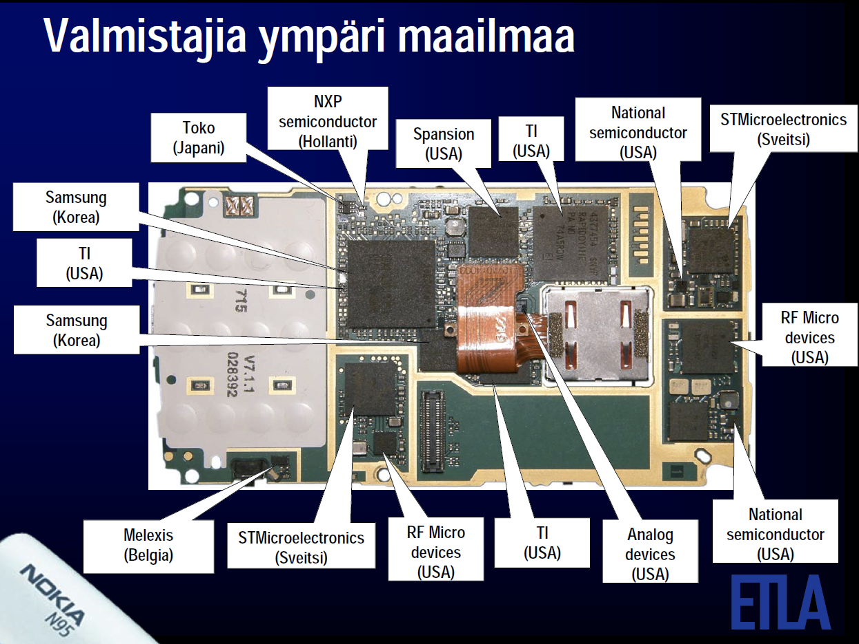
GLOBAL MANUFACTURING

Slide 52
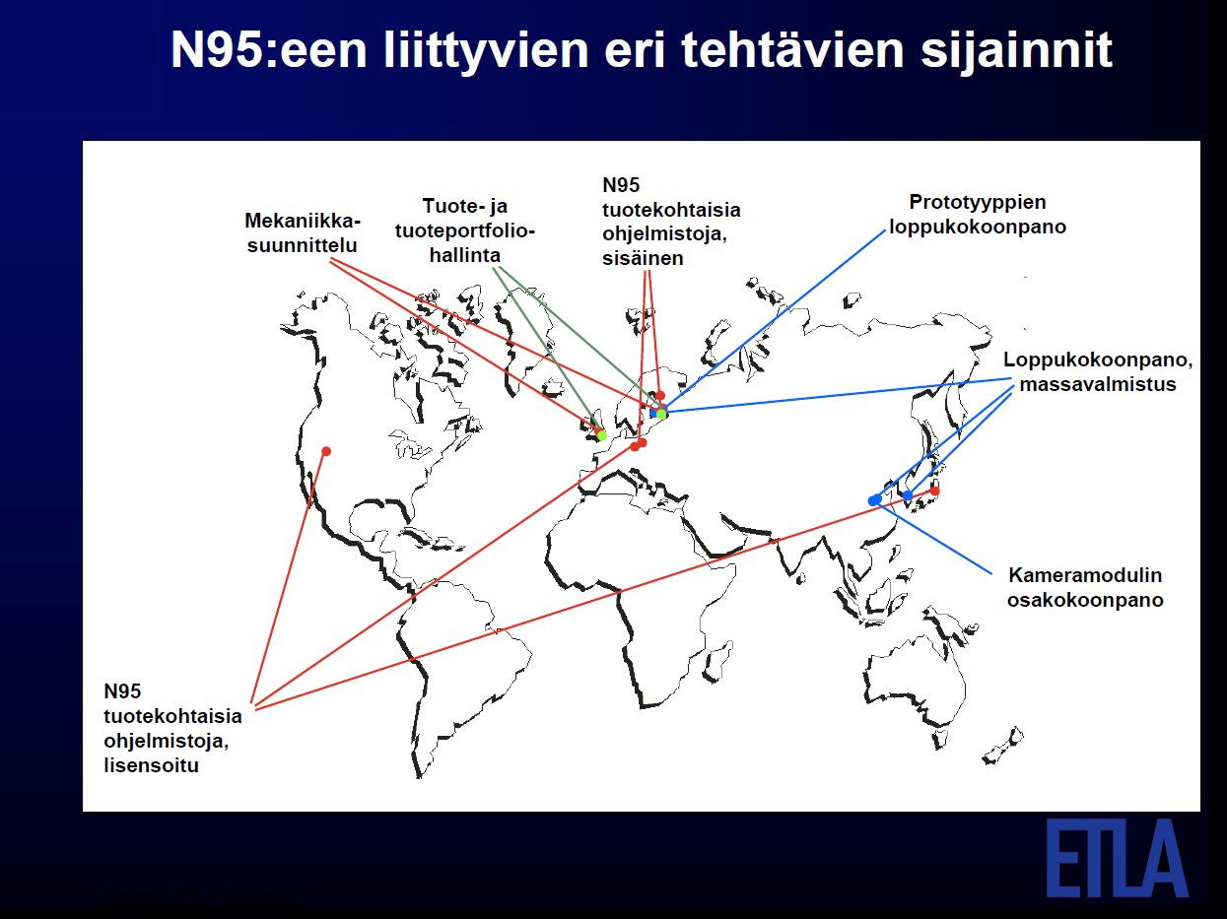
GEOGRAPHICAL TASK SPREAD FOR N95
NOKIA
SOFTWARE
FOR N95
FINAL
PROTOTYPE
ASSEMBLY
MECHANICAL
DESIGN
PRODUCT
AND
PORTFOLIOMGT
MASS
PRODUCTION
CAMERA
MODULE
ASSEMBLY
N95 SOFTWARE
LICENCED
(translation by AP)

Slide 53
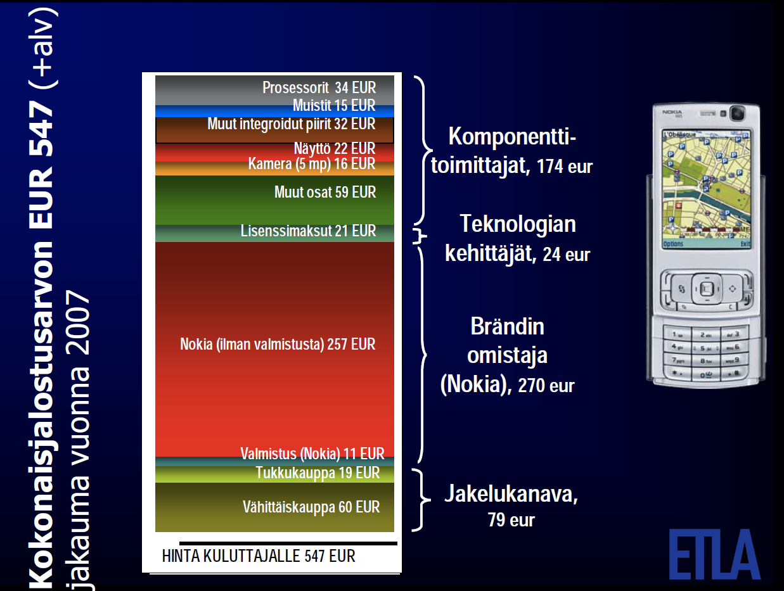
N95 TOTAL VALUE-ADDED 547€ (2007)
COMPONENT
SUPPLIERS 174€
TECH
DEVELOPERS 27€
BRAND
OWNER
DISTRIBUTION CHANNEL
QUESTION: WHERE SHOULD ONE BE POSITIONED? CHANGE BY 2016?

Slide 54
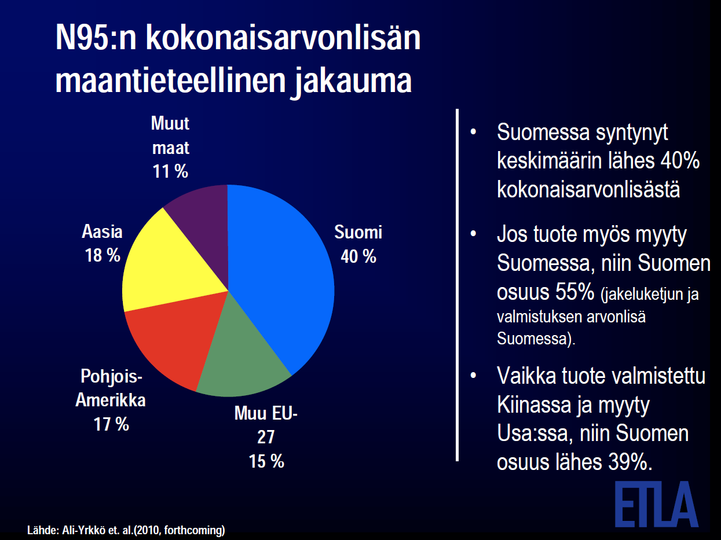
N95 TOTAL VALUE-ADDED
GEOGRAPHICALLY
OTHER
IF SOLD IN FINLAND,
FINNISH SHARE 55%
MANUFACTURED
IN CHINA, SOLD
IN THE US,
FIN = 39%
ASIA
FIN
NORTH
AMERICA
OTHER
EU27

Slide 55
The Kawasaki Questions
Who has got your money in his/her pocket?
How can you get it to yourself?

Slide 56
Heath&Heath: Made to Stick
Why do some ideas stick better?
Great interesting curious stories that we can tell further
Great ideas must be nurtured, made interesting and sustainable
Great ideas must be true
Sticky ideas are often infinitely stupid urban legends, jokes, wartime rumors, so what makes them stick????

Slide 57
Sticky is...
SIMPLICITY
  PROFOUND AND SIMPLE
UNEXPECTEDNESS
  OPEN GAPS IN KNOWLEDGE – AND FILL THEM
CONCRETENESS
  EXPLAIN IN TERMS OF HUMAN ACTION SO THAT THE STORY MEANS THE SAME TO EVERYONE
CREDIBILITY
  NUMBERS AND STATISTICS ARE NATURALLY SUSPECT
EMOTIONS
  CREATE FEELINGS
STORIES
  ARE MENTAL FLIGHT SIMULATORS

Slide 58
Sticky
Assessing how much of the message was received and understood
  Example: music tapping (120 songs)
  impossible to imagine not knowing = Curse of Knowledge
Find the CORE
  If you say three things you say nothing
  save customers from decision paralysis (Angst)
  Keep it very simple (a bird in the hand...) = short sentences drawn from long experience
  Avoid feature creep (VCR)
And SHARE it
  Names are important.....
  Share with the staff, too

Slide 59
12 innovations that shaped modern management (HBR Feb 2006, p.80)
Scientific management (time and motion studies)
Cost accounting and variance analysis
The commercial research laboratory (the industrialisation of science)
ROI analysis and capital budgeting
Brand management
Large-scale project management
Divisionalization
Leadership development
Industry consortia (multicompany collaborative structures)
Radical decentralization (self-organization)
Formalized strategic analysis
Employee-driven problem solving
-----------------------------------
knowledge management
open source development
internal markets

Slide 60
Where is the Clue?
INNOVATIONS ARE NOW WIDELY REGARDED AS STORIES
INNOVATIONS ARE INCREASINGLY CARRIED OUT IN NETWORKS = OPEN INNOVATION
CUSTOMERS ARE NO LONGER JUST TARGETS, THEY ARE PART OF THE PRODUCT
BUSINESS MODEL INNOVATIONS ARE PROBABLY THE STRONGEST MOVERS
  FREE OFFERS: SKYPE, GOOGLE, FACEBOOK, SOME AIRLINES
  BUSINESS MODELS ARE POORLY HANDLED IN LITERATURE
THOUSANDS OF ENTREPRENEURS
IMMEDIATELY SELLING GLOBALLY
ANGRY BIRDS (ROVIO, FIN!!)

Slide 61
Early predecessors, technology-driven
Bellamy (1888) Looking Backward (about a city in the year 2000; music-telephone)
H.G.Wells (1895) The Time Machine (about time being the converging fourth dimension moving people back and forth) (parallel to today’s virtual world?)
Orwell (1949) Nineteen Eighty-Four (ubiquitous control and communication technology)
Kubrick (1968) 2001: A Space Odyssey (HAL the supercomputer, with even feelings; artificial intelligence)
Technotopia = utopian ideas + tech development (Leonardo was a technotopian)
Barber (1984) ”The capabilities of new technology can be used to strengthen civic education, guarantee equal access to information, and tie individuals and institutions into networks that will make real participatory discussion and debate possible across great distances”

Slide 62
Back to basics: the 4 disciplines of innovation (Carlson & Wilmot)
Create customer value, your only job
  Work on needs, every business is a stage
    Acting is takind deliberate steps to connect with an audience
Empower value creation in your organisation
  Openness everywhere (LINUX, various web-based media solutions)
  The better we get, the better we get at getting better
  Create intrapreneurship (is this really possible, rewarding failure!!)
Charles S. Jacobs: MANAGEMENT REWIRED, Portfolio/Penguin 2009)

Slide 63
and more...
Create critical mass, teams do it better
  Beware of: cynicism; passive-aggressive, behind-the-back; end runs
  Achievement, empowerment, involvement
Begin immediately
  Remove barriers of newness
  Avoid muda (wasteful and unproductive activities)

Slide 64
To Summarize...
Innovative Value is increasingly co-created with the customer (in rich and poor countries alike)
Few companies contain all the skills, knowledge, and resources for this => openness
Outsourcing will explode due to improved digital platforms (clouds etc.)
Emerging markets are highly important
See Prahalad&Krishnan (2008) New Age of Innovation – Driving Co-Created Value Through Global Networks

Slide 65
And Tomorrow Something Completely Different…
ECONOMICS
OF
SCARCITY
ECONOMICS
OF
SHARING
LARGE COMPANY DRIVEN
PATENT AND COPYRIGHT-DRIVEN
ECONOMIES-OF-SCALE –DRIVEN
GOVERNMENT-DRIVEN
MUSIC INDUSTRY, LARGE TECH (IBM, NOKIA...)
PRINTED MEDIA VS INTERNET
COPYRIGHT IS DEAD, INTELLECTUAL CAPITAL NOT?
IMPACTS ALL BUSINESSES
PROSUMERISM
BENEFITS ENTREPRENEURSHIP & SMES?
READ: Lawrence Lessig (200x) Remix
Michael Heller (2008) Gridlock Economy

Slide 66
IS ENTREPRENEURSHIP
ABOUT HARD AND TOUGH
BUSINESS ONLY VALUES
???

Slide 67
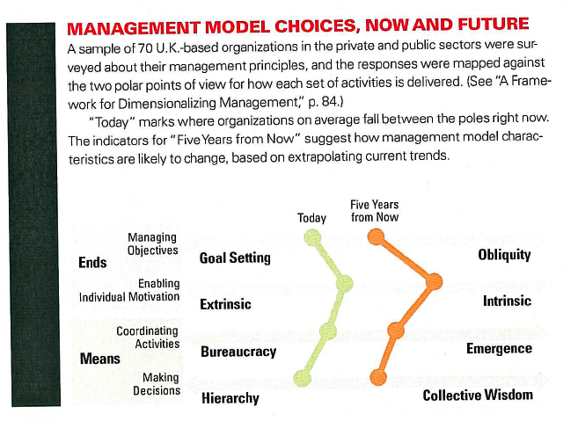

Slide 68
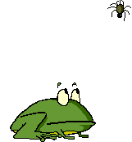
Capitalism Changes, too
THE RATIONAL
OPPORTUNITY-SEEKING
PROFIT-DRIVEN
FUNDAMENT
OF BUSINESS
Kay: THE OBLIQUE BUSINESS PHILOSOPHY
Hamel: THE FUTURE OF MANAGEMENT
Chesbrough: OPEN INNOVATION; OPEN BUSINESS MODELS
MODERN BRAIN RESEARCH
---
INDUSTRIES AS CONSTANTS
GROWTH AS CONSTANT
LARGE BIZ AS CONSTANT
TECH-PUSH AS CONSTANT; ”BUILD IT AND THEY WILL COME”
---------
ANYTHING GOES AS LONG AS IT MAKES MONEY?
BUSINESS AS CASINO?
EXPECTATIONS-DRIVEN ECONOMY (QUANTIFIABLE?)
PICKING THE WINNERS?
”SERVE SOMETHING VALUABLE AND PROFITS WILL COME”
MANAGEMENT ITSELF IS UNDER INNOVATION
  ILLUSION OF CONTROL
THE REJECTED INNOVATION PROPOSALS CREATE MORE VALUE
70 – 90 % OF ALL HUMAN DECISIONS ARE BASED ON INTUITION
NOT: FORESEEING TURNING POINTS/TECH BUBBLES, FINANCE BUBBLES,
BLACK SWANS...

Slide 69
Organizational Evolution 1900 – 2000 I
E
LARGE INDUSTRIAL CONGLOMERATE AS IDEAL
LARGE WAS CONSIDERED ALWAYS BETTER, MARKET MONOPOLY AS A GOAL
(TOO) EXTREMELY WELL PLANNED, TOP-DOWN
STRATEGIC PLANNING (FORECASTING-DRIVEN)
HIGHLY DETAILED AND STATIC PROFESSIONAL QUALIFICATIONS (SILOS)
OFTEN PRICING-DRIVEN (THINK MEDIA)
CONTROL-DRIVEN
JOBS ACCORDING TO FORMAL EDUCATION
CUSTOMERS ... HMMM....
THIS IS HOW BUSINESS ECONOMICS IS STILL (ALMOST) STRUCTURED!
1973
Robert Anthony (1965) Planning and Control Systems
Igor Ansoff (1965) Strategic Planning

Slide 70
Organizational Evolution 1900 – 2000 II
STRATEGIC MANAGEMENT, WEAK SIGNALS
FROM FORECASTS TO SCENARIOS
FROM TOP-DOWN TO MARKET-DRIVEN
MANAGEMENT SIMPLIFIED (ROI), LEADERSHIP IN
EVERYTHING MARKET-DRIVEN
BUSINESS PHILOSOPHY IS EFFICIENCEY AND PROFITABILITY –DRIVEN
STILL BIG IS BEAUTIFUL
PETERS&WATERMANN (1983) In Search of Excellence: Management, business culture....
HEADQUARTERS
E
E
PC1
PC2
PC3
WHY THIS MODEL?
ANY THEORETICAL GROUNDS?
WAS THIS A MOVE TOWARDS ENTREPRENEURSHIP?
1983
HOW, WHY NOT?

Slide 71
Organizational Evolution 1900 – 2000 III
THE FIRST ENTREPRENEURSHIP-DRIVEN ORGANIZATION MODEL
BUs CLOSER TO A REAL SME
OPEN ORGANIZATION
OPEN INNOVATION
INTELLECTUAL CAPITAL
INCENTIVE-DRIVEN
CUSTOMER-DRIVEN
CHALLENGES
  Culture
  Strategy
  Trust
  Finance
  Investment
  Profit-sharing...
BU6
BU1
E
BU5
HQ
E
BU2
BU5
BU3
BU4
2003
E
IS THIS ENTREPRENEURSHIP???

Slide 72
Structural change towards entrepreneurship
+
+
MANAGEMENT
LEADERSHIP
ENTREPRENEURSHIP
Planning
Efficiency
Network
RULES AND ORDERS
PLANNING, STAFF
BUDGETING, REPORTING
COSTING
RESOURCE BASED
OWNERSHIP/POWER
WEAK CUSTOMERS
STRATEGISM:
CORE STAYS, ALL ELSE REMOVED
ROI
PRODUCTIVITY: MACHINES/HUMANS
MARKET APPROACH INSIDE/OUTSIDE
MARKET PRICECS ”ALWAYS”
CUSTOMER-DRIVENNESS
GENUINELY CUSTOMER-DRIVEN
KNOWLEDGE-DRIVEN
INNOVATION/CREATIVITY
INCENTIVES, EMPOWERMENT
STRUCTURE ➔ PROCESS
VIRTUALITY
EXPECTATIONS, GROWTH
TRUST
NEW MANAGEMENT
BRING CUSTOMERS INSIDE!

Slide 73
The 4th Generation organization?
E culture
C
CUSTOMER-DRIVEN
BRAND-DRIVEN
LOYALTY-DRIVEN
INNOVATION-DRIVEN
EXPECTATIONS-DRIVEN
DEEPLY SENSITIVE AND ALERT
THOROUGHLY ENTREPRENEURIAL
SUSTAINABLY DISRUPTIVE
OPEN
...
C
BU6
BU1
C
BU5
BU2
HQ
BU5
C
BU3
BU4
C
C
C
BUT
Can everything really be outsourced???
C
C
READING: Prahalad & Krishnan (2008) The New Age of Innovation – Driving Co-created Value Through Global Networks

Slide 74
CONVERGENCE?
THE INSIDE
THE OUTSIDE
TRENDS
AND
DEVELOPMENTS
IN
ENTREPRENEURSHIP,
INNOVATION
AND
GROWTH
LOW HIERARCHIES
ENTREPRENEURIAL CULTURE
INTENSIVE EMPOWERMENT
DYNAMIC OWNERSHIP
CONTEXT INCENTIVES
CONTINUOUS OPEN INNOVATION
OPEN BUSINESS MODELLING
OBLIQUE OBJECTIVES
ANTI-SILO ATTITUDE
AGILITY
ANTI-CONTROL (!?)
CULTURES (m&a)
NETWORKED OPERATIONS
DEEP CUSTOMER INVOLVEMENT
PROSUMERISM
EXPECTATIONS MANAGEMENT
GROWTH/CHANGE AS GOAL
COPETITION
SHARING VS. IPR
CUSTOMER RETENTION
HYBRID BUSINESS
CULTURES

Slide 75
The mainstream business model is now under reconsideration
OLD 1: Big dogs own the street
New 1: Agile is best; being big can bite you
  economies of scale used to dominate
  big market share meant big profits
  then in 1993, Microsoft’s market cap passed IBM’s
  today, GM is junk
  large today is three times larger than large in 1980, thus much harder to manage
  big pharma is now dependent on small, cutting-edge biotech firms
  DELL turned the business model around (and then the business model almost turned DELL around...)
  SKYPE did everything in two years with less than 60 people

Slide 76
NEW BUSINESS MODEL
OLD 2: Be no. 1 or no. 2 in your market
NEW 2: Find a niche, create something new
  AOL vs. Google
  Coke to Evian and sports drinks to health
  Starbucks: ”we’ve never said we wanted to be No. 1 or No. 2”
  think Hesburger….
  Good Old Rule: Put 20 % of everything into change!

Slide 77
NEW BUSINESS MODEL
OLD 3: Shareholders rule
NEW 3: The customer is king
  very often customers and company leadership disagree on performance ( every four years, the average company loses more than half its customers)
  very often the balance of benefit between customer and company is not right
  think Apple = dream the dreams customers dream
  make employees proud, that is a powerful engine

Slide 78
NEW BUSINES MODEL
OLD 4: Be lean and mean
NEW 4: Look out, not in
  from reduce costs… to …
  SKYPE (VoIP) again….
  do still Six Sigma….

Slide 79
NEW BUSINESS MODEL
OLD 5: Rank your players: Go with the A’s
NEW 5: Hire passionate people
  who can rank talent: talent
  you need their hearts, too!
  unhappy talented employees constitute a great risk

Slide 80
NEW BUSINESS MODEL
OLD 6: Hire a charismatic CEO
NEW 6: Hire a courageous CEO
  is it short-term or long-term
  are we too impatient?
    think from analog to digital (Xerox, Sony…)
  change when you are on top

Slide 81
NEW BUSINESS MODEL
OLD 7: Admire my might
NEW 7: Admire my soul
  be long-term greedy, instead of short-term greedy
  Obliquity (indirect) is the key (is it?)
  responsible business is an asset (is it?)

Slide 82
BUILD IT AND THEY WILL COME ???
  Is Technology Push still a valid model?
  Why do some good technologies fail and others (maybe worse) succeed?
    Pip Coburn: It is about PROBLEMS USING THE OLD TECHNOLOGY VS. THE PAIN OF ADOPTION THE NEW ONE
    Stories, again!
    Chesbrough: Rejected Innovations make more value!!!
      It is about the whole ecosystem and entrepreneurship (again!)

Slide 83
ENTREPRENEURIAL ASPECTS OF STARTING-UP A NEW BUSINESS

Slide 84
New Business Evolution
PERFORMANCE
0...
BUSINESS
PLANNING
1
HIGH
GROWTH
100
IDEA
DEVELOPMENT
LOW
GROWTH
50
TIME
300
SOURCES
BIZ PLAN
HELPS
A LOT!
(DEATH VALLEY) SURVIVAL

Slide 85
INPUT | Finland | Israel | Massachusetts
Population | 5.2 | 6.9 | 6.3
Academic degrees % | 25 | 24
Start-ups p.a. | 23 000 | 20 000 | 27 000
R&D of GNP | 3.3 | 4.1 | 4.9
Patents/million inhabitants | 166 | 186 | 300
New venture capital p.a. | 100 | 100 | 150
OUTPUT | Finland | Israel | Massachusetts
New investment average (M€) | 0.2 | 1.9 | 4.3
Invested total p.a (M€) | 124 | 1 140 | 1 660
Companies on international growth company list | 4 | 44 | 36
IPOs p.a. | 1 | 35 | 9
Early-stage active investors | 10 | 60 | 50
Large company international research centres | 5-6 | 30-40 | 10-20
Source:
VICTA
Finance? Universities? Location? Networking? Ambition?

Slide 86
Money makes the world go round...
PERFORMANCE
IPO
HIGH
GROWTH
BUSINESS
PLANNING
ACCELERATION
EQUITY
SOFT LOANS
INCUBATION
IDEA
DEVELOPMENT
LOW
GROWTH
Cash flow, venture capital
VENTURE CAPITAL, (BANKS)
TIME
SOURCES
DEATH VALLEY SURVIVAL
WHY NOT BANKS.....WHY 5-7 YEARS VENTURE CAPITAL??

Slide 87
Terminology used (usually...)
IPO
Large multinationals
Global gorillas
VENTURE CAPITAL
CORPORATE
VENTURING
BUSINESS ANGELS
Fast growth
gazelles
UNIVERSITIES
& OTHER INNOVATION ACTORS
RISK CAPITAL
FUNDS
Early-stage
Start-up stage business plan
Invention of
business
opportunity
Pre-seed: business idea development to business plan
INCUBATOR
SUPPORT

Slide 88
Venturing
1 or 2 out of ten are successful
High to very-high IRR targets (25 – 40 %) are common

Slide 89
IRR 25% means...
PV of ”1”
NOTHING MATTERS TO DECISION-MAKING AFTER 5-7 YEARS
1
0.3
0.1
TIME
0
5
10

Slide 90
Failure reasons ”top 8”
Insufficient seed capital
Inadequate management capability (”In giving advice, seek to help, not please, your friend”)
Lack of customer focus
Loss of entrepreneurial spirit and renewal/innovation
Production mismanagement
Bad accounting
Overwhelming events by markets or competitors
Fraud

Slide 91
Getting there faster...
BUSINESS PLAN
FINANCING PROGRAM
MGT COMPETENCE
BOARD SUPPORT
KNOWLEDGE
NETWORKING
MARKETING
RECRUITING TALENT
………
--------------------
LOOKING BEYOND
1
IPO or…
NewBiz Centre
BizLab
(BOOST) Incubator
100
Accelerator
Incubator
50

Slide 92
GROWTH AND FINANCE
REVENUE = TURNOVER
OPERATING PROFIT
NET
WORKING
CAPITAL
CHANGE
INTEREST TAXES DIVIDENDS INVESTMENT
CAPITAL FINANCING

Slide 93
Henry Ford:
“Whether you believe you can or you can’t, you’re right.”
SEE ALSO:
http://www.extremetour.org/speakers

